Slide 1
Water Consumption Data Analysis Using Machine Learning
An in-depth exploration of water consumption patterns and predictive modeling.
Ravallika Kadiyala

Slide 2
Overview of the Analysis
Introduction to the Dataset:
Dataset on water consumption and charges from 2013 to Feb 2023.
Focus on predicting charges and analyzing consumption trends.
Key Objectives:
Regression Modeling (Linear Regression)
Classification Modeling (Decision Tree)
Clustering (K-Means)
Time Series Analysis (ARIMA)

Slide 3
Data Preprocessing
Load Dataset:
Used pandas to load data (pd.read_csv()).
Data Cleaning:
Handle missing values using dropna().
Convert date columns to datetime format.
Create new feature:
Consumption_per_day (HCF / days).
Data Transformation:
Encode target variable Estimated (Yes/No to 1/0).
Split data into features (X) and target (y).

Slide 4
Feature Engineering and Cleaning
Consumption per Day:
Consumption_per_day = Consumption (HCF) / # days
Helps normalize consumption based on the number of days.
Handling Large and Infinite Values:
Replaced infinite values with NaN and dropped them.

Slide 5
Train-Test Split
Split Dataset:
80% for training and 20% for testing.
Used train_test_split from sklearn to ensure model validation.

Slide 6
Linear Regression Model
Model Overview:
Predicting Current Charges using Consumption (HCF).
Fitted linear regression model using LinearRegression() from sklearn.
Evaluation Metrics:
Mean Absolute Error (MAE): 3217.02
Mean Squared Error (MSE): 37815205.22
Root Mean Squared Error (RMSE): 6149.41
Insights:
Linear model performs well, but higher consumption values indicate potential issues with model fit at extremes.

Slide 7
Decision Tree Classification
Model Overview:
Classifying whether a bill is Estimated (Y/N).
Decision Tree Classifier using DecisionTreeClassifier().
Model Performance:
Accuracy: 90.8%
Precision: 61.8%
AUC: 0.77
Insights:
The decision tree has high accuracy but could benefit from further tuning for better precision and recall balance.

Slide 8
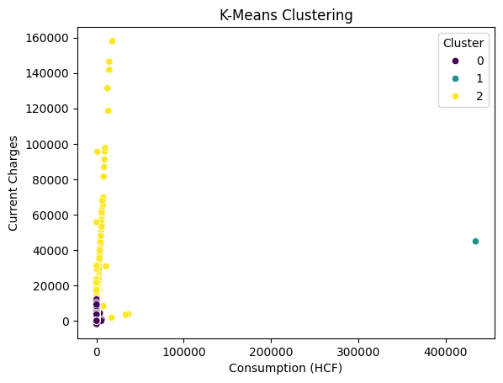
K-Means Clustering
Clustering Overview: Applied K-Means clustering to segment the data into 3 clusters.
Features used: Consumption (HCF) and Current Charges.
Visualizing Clusters: Scatter plot of clusters showing consumption vs charges.
Insights: Most data points cluster in one region, but outliers are also visible.
Clustering Insights: Clusters help identify distinct customer types based on consumption patterns.

Slide 9
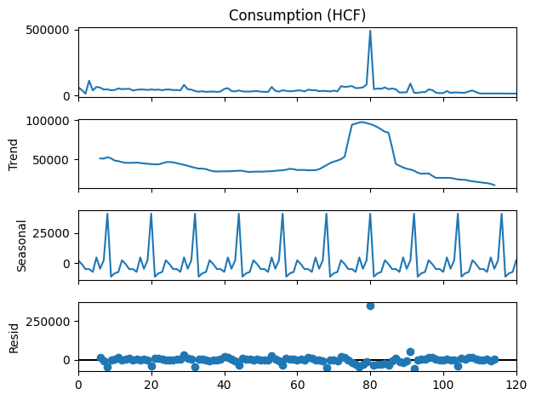
Time Series Analysis
Overview:Analyzing Consumption (HCF) over time to detect trends and seasonal patterns.Grouped data by Revenue Month and performed time series decomposition.
Trend: Shows long-term consumption patterns.
Seasonal: Captures periodic fluctuations (e.g., higher consumption in certain months).
Residual: Represents random fluctuations (noise).
ARIMA Model:Model summary from ARIMA(1, 1, 1) for future consumption forecasting.

Slide 10
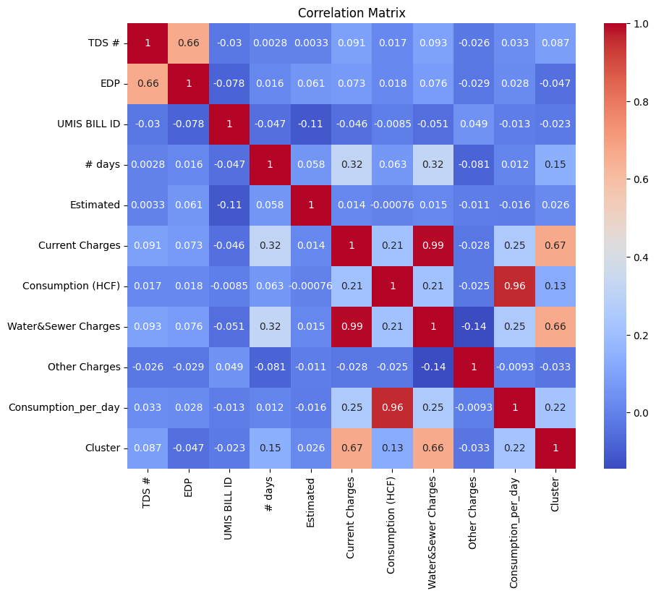
Correlation Analysis
Correlation Matrix: Visualized correlations between numerical features in the dataset. Strong correlation between Consumption (HCF) and Water & Sewer Charges (0.99), and Current Charges.
Insights: These features are key predictors for model performance.
Interpretation: Understanding how consumption and charges are interrelated is critical for building accurate models.

Slide 11
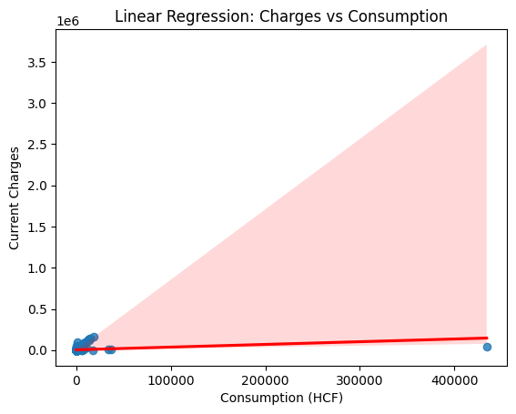
Regression Plot
Visualization: Linear regression plot between Consumption (HCF) and Current Charges. Red line represents the model’s prediction.
Insights: Indicates a good fit for lower values of consumption but struggles with higher values, suggesting a potential non-linear relationship.

Slide 12
Model Evaluation Summary
Linear Regression Results:
MAE: 3217.02, MSE: 37815205.22, RMSE: 6149.41
Decision Tree Results:
Accuracy: 90.8%, Precision: 61.8%, AUC: 0.77
Key Takeaways:
Linear Regression provides a baseline, but higher consumption requires advanced modeling. Decision Trees offer good classification accuracy but need tuning for precision.
Future Work:
Explore other regression techniques for better model fit. Fine-tune decision tree for precision and recall balance.

Slide 13
Visualizations Summary
Correlation Matrix:
Shows key relationships between features, essential for prediction.
Time Series Decomposition:
Breaks down consumption trends and seasonal behavior, crucial for forecasting.
K-Means Clustering:
Helps identify distinct customer behavior segments.
Regression Plot:
Indicates areas for model improvement, especially for higher consumption values.

Slide 14
Conclusion
Summary:
Successfully built predictive models (Linear Regression and Decision Trees).
Used clustering for segmentation and time series analysis for trend forecasting.
Impact:
Provides insights into consumption behavior, charges prediction, and potential optimizations.
Useful for smart city water management and governance.

